Slide 1

MAT205: Abstract Algebra II
1. Basics
Ma, Jia-Jun

Slide 2
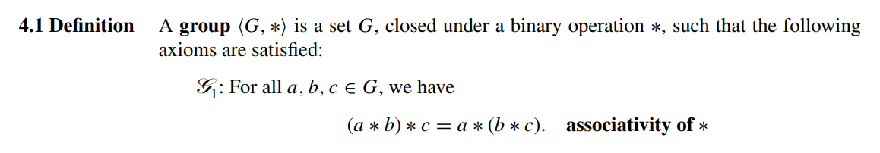
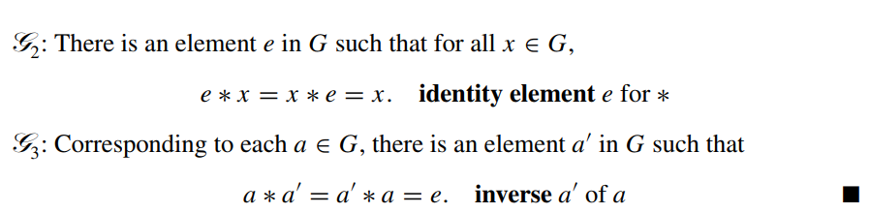

Slide 3

Examples
$\{1\}$
$(ℤ, +)$
$\left\{±1\right\}$
$ℤ/nℤ$
$S_{n}$permutation group of $n$ letters
${GL}_{n}\left(ℂ\right)$
${SL}_{n}\left(ℂ\right)$

Slide 4

Non-Examples
$\left(ℤ^{×}, ∙\right)$

Slide 5
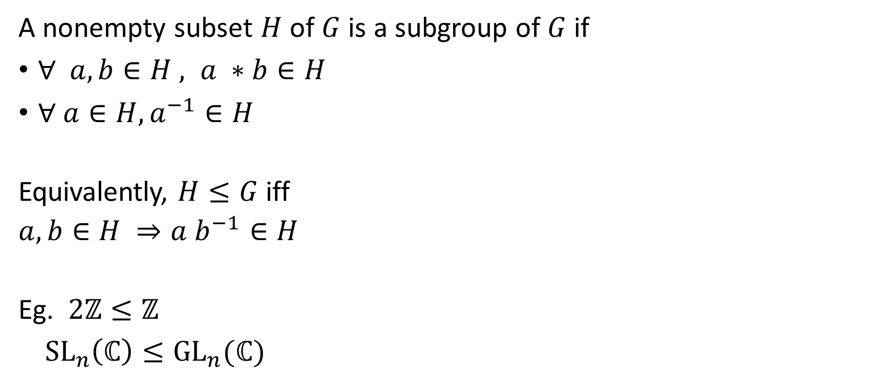
Subgroup
A nonempty subset $H$ of $G$ is a subgroup of $G$ if
$∀ a, b∈H , a ∗b∈H$
$∀ a∈H, a^{−1}∈H$
Equivalently, $H≤G$iff
$a,b∈H ⇒a b^{−1}∈H$
Eg. $2ℤ≤ℤ$
${SL}_{n}\left(ℂ\right)≤{GL}_{n}(ℂ)$

Slide 6
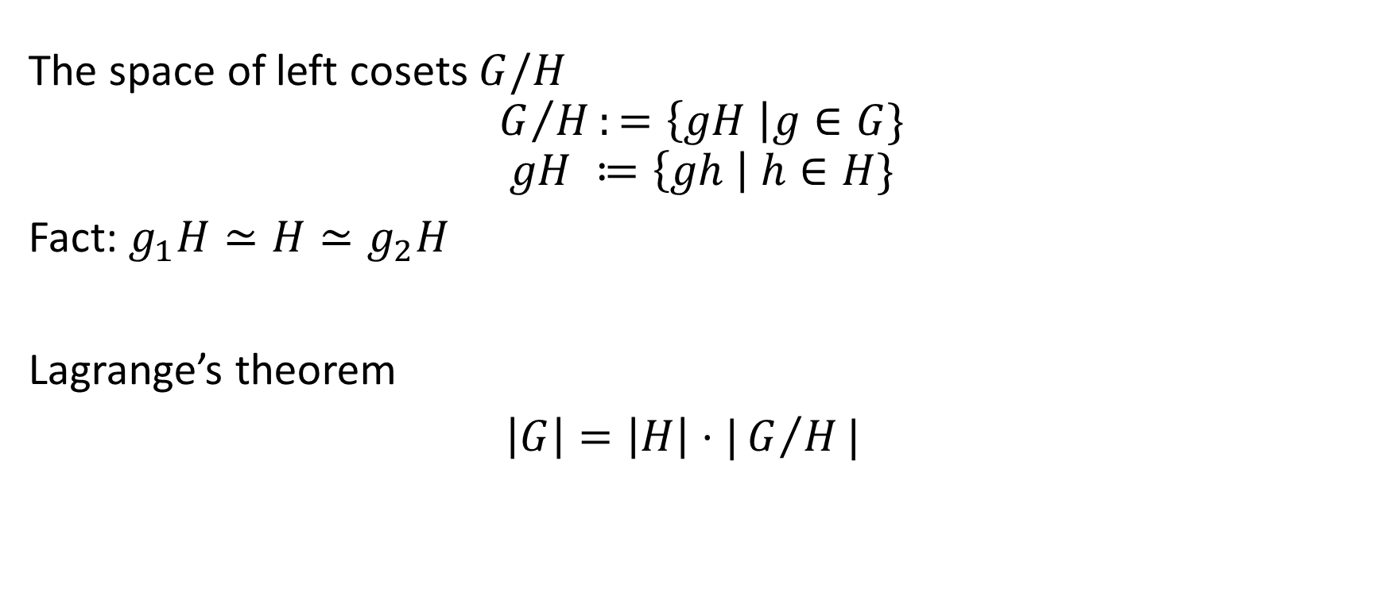

Coset space: Suppose $H<G$
The space of left cosets $G/H$
$$G/H:=\left\{gH \right|g∈G\}$$
$$gH ≔\left\{gh \right| h∈H\}$$
Fact: $g_{1}H≃H≃g_{2}H$
Lagrange’s theorem
$\left|G\right|=\left|H\right|⋅|G/H|$

Slide 7

Coset space (example)
${G= ℤ}_{6}$, $H=3 ℤ_{6}$

Slide 8

Consequence of Lagrange’s theorem
If $G$ is a finite group, $H≤G$ then $\left|H\right|$divides $|G|$.
$ℤ_{p}$ is a simple group.

Slide 9
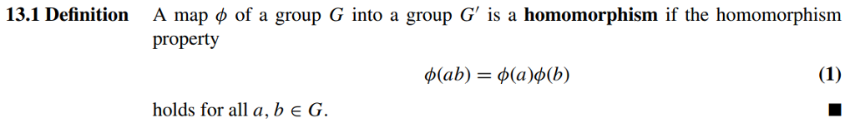
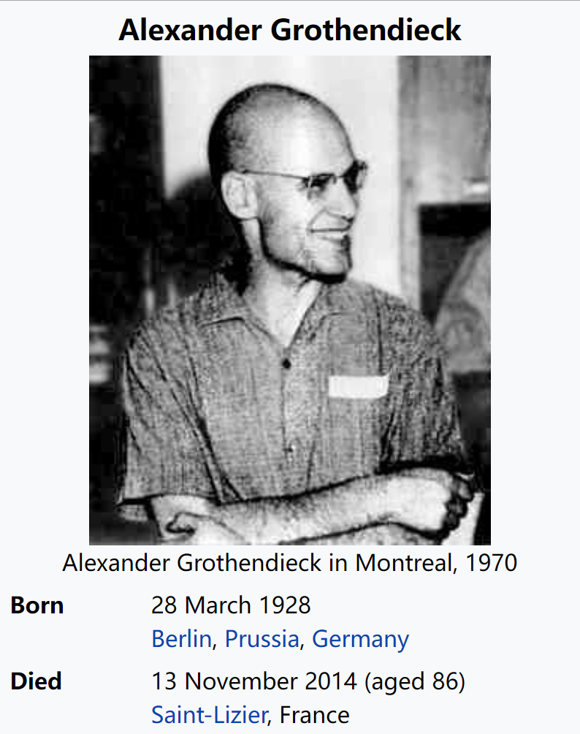

Group homomorphism
Corollary
$$φ\left(e_{G}\right)=e_{G′}$$
$φ\left(a^{−1}\right)=φ{\left(a\right)}^{−1}$
Grothendieck pointed out that
rather than analyzing objects, we should concentrate on morphisms between them.

Slide 10
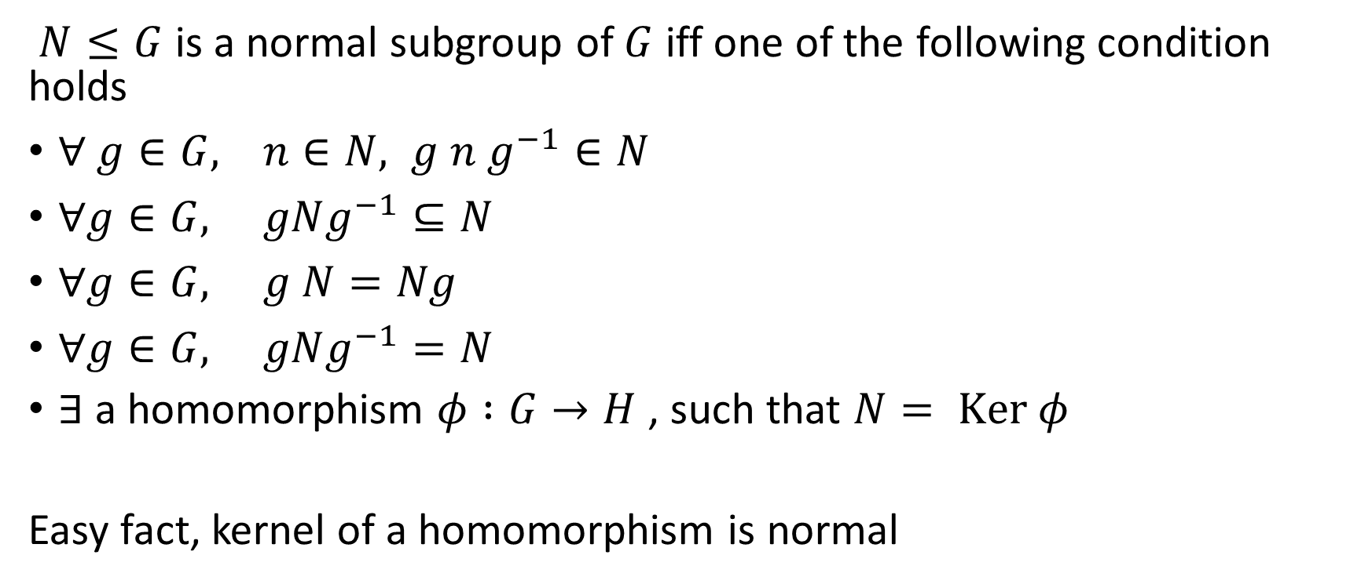
Normal subgroups
$N≤G$ is a normal subgroup of $G$ iff one of the following condition holds
$∀ g∈G, n∈N, g n g^{−1}∈N$
$∀g∈G, gNg^{−1}⊆N$
$∀g∈G, g N=Ng$
$∀g∈G, gNg^{−1}=N$
$∃$a homomorphism $φ :G→H$, such that $N= Ker φ$
Easy fact, kernel of a homomorphism is normal

Slide 11
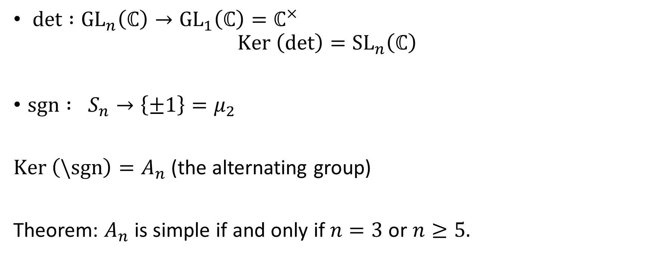
Examples
$det :{GL}_{n}\left(ℂ\right)→{GL}_{1}\left(ℂ\right)=ℂ^{×}$
$$Ker \left(det\right)={SL}_{n}\left(ℂ\right)$$
$sgn : S_{n}→\left\{±1\right\}=μ_{2}$
$Ker \left(\backslash sgn\right)=A_{n}$ (the alternating group)
Theorem: $A_{n}$ is simple if and only if $n=3$ or $n≥5.$

Slide 12

Simple group
A group $G$ is called a simple group if the trivial subgroup and $G$ are the only normal subgroups of $G$.
Question: Classify all finite abelian simple groups.

